Slide 1


Title: Event Ticketing DApp: A Blockchain-based Solution for Secure and Transparent Ticketing
Subtitle: Developed by [parasamsa]
Date: [24-11-2024]

Slide 2
Motivation and Problem:
The inspiration behind this project came from the challenges that both event organizers and ticket buyers face when dealing with traditional ticketing systems. The process often feels disconnected, expensive, and insecure. As a buyer, you’re unsure if your ticket is genuine, and as an organizer, you're paying high fees to third-party platforms that control your sales. I wanted to create a system that makes ticketing simpler, more transparent, and less costly for everyone involved.
A major issue with traditional ticketing systems is that fraudulent tickets can easily be created and sold. This leads to people buying fake or duplicate tickets, and event organizers have no easy way to track or prevent this.
Traditional platforms often charge high fees for processing tickets and handling payments. These platforms also act as middlemen, taking control away from event organizers and increasing costs for buyers.

Slide 3
Blockchain Integration:
Blockchain is used in this project to solve key problems in event ticketing:
Preventing Ticket Fraud: Each ticket is a unique digital token (NFT) on the blockchain, which ensures that tickets cannot be duplicated or counterfeited.
Ensuring Transparency: All transactions (ticket sales, funds, event details) are recorded on the blockchain, providing full visibility and trust for both organizers and buyers.
Reducing Fees and Middlemen: Blockchain eliminates the need for third-party platforms (like Ticketmaster), allowing organizers to manage sales directly and reducing transaction fees.
Smart Contracts for Automation: Smart contracts automate processes like ticket issuance and fund withdrawals, reducing manual work and errors.

Slide 4
System Architecture:
The system is designed to be a Decentralized Application (DApp) that runs on the Ethereum blockchain. It uses smart contracts to manage event creation, ticket sales, and fund management without the need for centralized intermediaries.
Frontend (UI):
Built with React for user interface and Web3.js or Ethers.js to interact with the Ethereum blockchain.
Displays events, allows users to purchase tickets, and enables organizers to create events and manage ticket sales.
Backend (Smart Contract):
Solidity smart contracts deployed on the Ethereum blockchain handle event creation, ticket issuance, ticket purchases, and fund management.
Blockchain:
Ethereum network is used for its smart contract capabilities. The blockchain ensures that all data related to ticket transactions and event details is secure, transparent, and immutable.

Slide 5
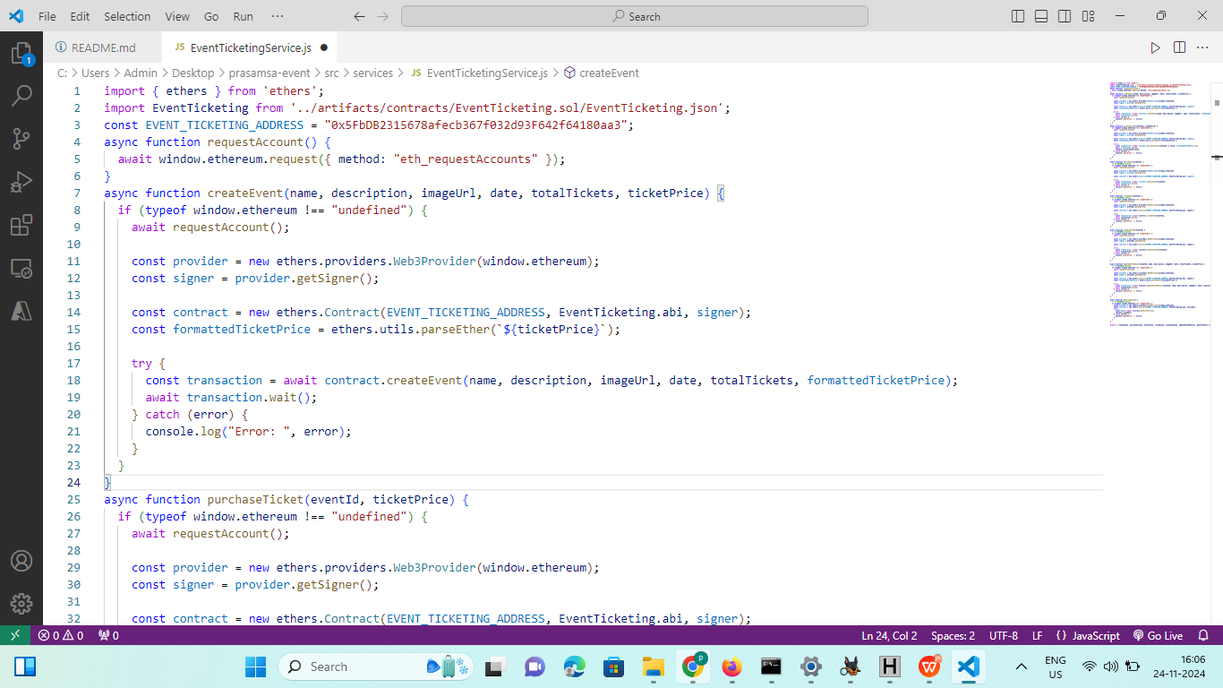

Slide 6
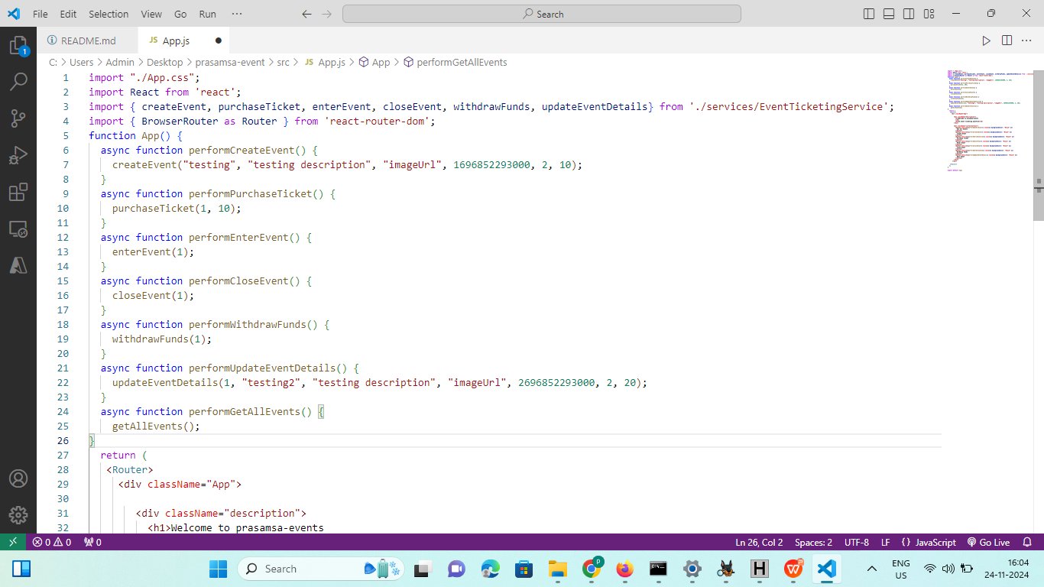

Slide 7
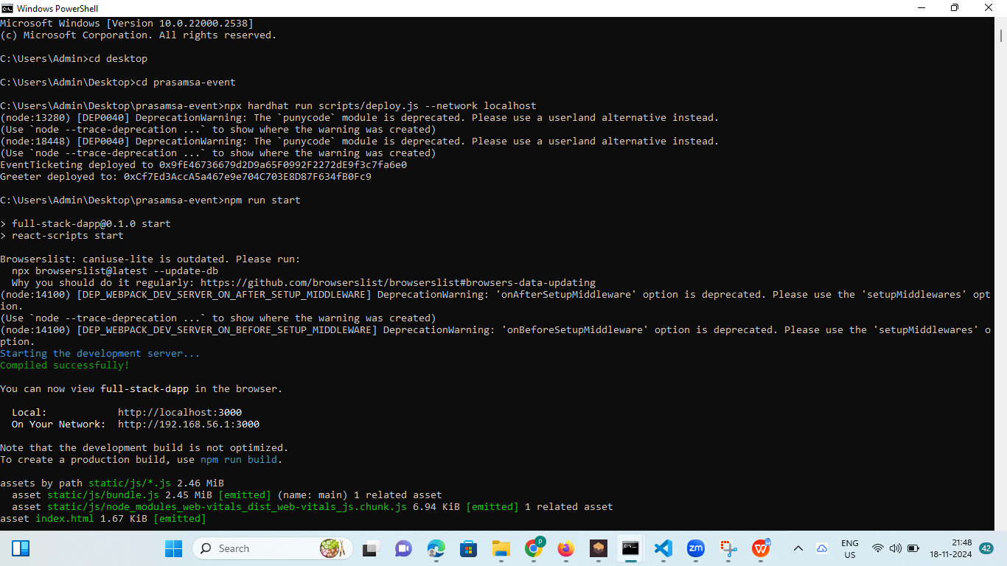

Slide 8
https://github.com//event-ticketing-dapp.git
Conclusion
This Event Ticketing DApp solves key problems in traditional ticketing systems like fraud, high fees, and lack of transparency. By using blockchain technology, we’ve created a secure, transparent, and cost-effective platform where:
Tickets are unique and verified, preventing fraud.
Transactions are transparent, ensuring trust between buyers and organizers.
No middlemen, reducing fees for both event organizers and buyers.
Smart contracts automate processes, making ticket sales and fund management faster and more efficient.
Future Directions:
Improve scalability with Layer 2 solutions.
Add dynamic pricing and a secondary ticket marketplace.
Develop a mobile app for easier access.
Integrate with other event management tools and explore NFT-based access.
This project creates a simpler, cheaper, and more reliable way to handle event ticketing.

Slide 9
THANK YOU

